Slide 1
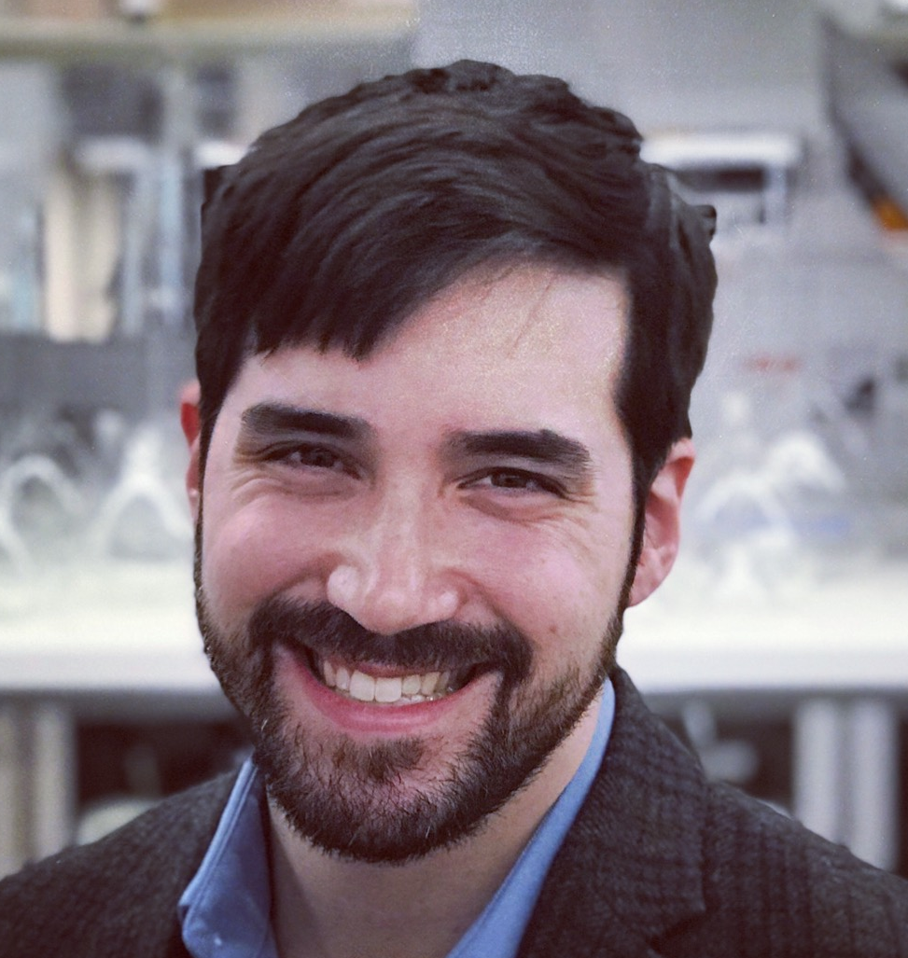
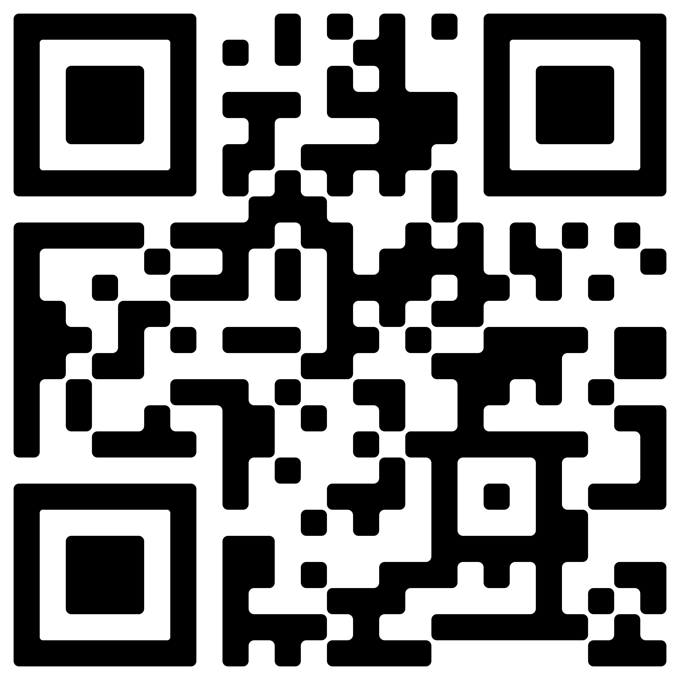
David M. Warsinger, PhD (MIT)
Assistant Professor
dwarsing@purdue.edu
www.warsinger.com
@warsingerlab
o 765-494-xxxx
SCHOOL OF MECHANICAL ENGINEERING
Birck Nanotechnology Center
Office Rm 2266
1205 W State Street
West Lafayette, IN 47906

